Slide 1



Slide 2
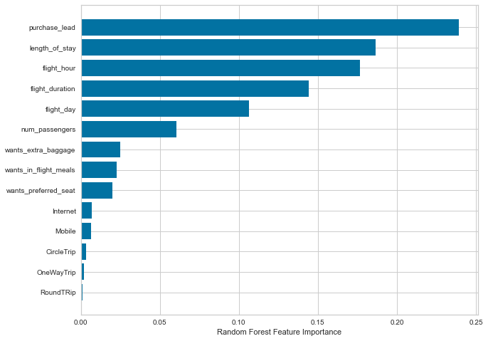
Predictive Modelling
RECALL RATE
57%
PRECISION
61%
ACCURACY
62%
Features capable of driving more successful flights.

